Slide 1

Lesson 8 – Aggregates Data Types Python Lists & Tuples
Notes:
Note from Chuck. If you are using these materials, you can remove the UM logo and replace it with your own, but please retain the CC-BY logo on the first page as well as retain the acknowledgement page(s) at the end.

Slide 2
What is Not a “Collection”?
Most of our variables have one value in them - when we put a new value in the variable, the old value is overwritten
$ python
>>> x = 2
>>> x = 4
>>> print(x)
4

Slide 3
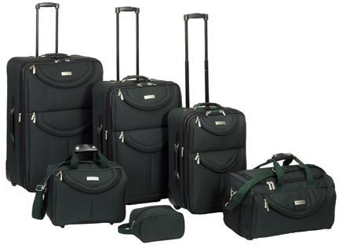
A List is a Kind of Collection
A collection allows us to put many values in a single “variable”
A collection is nice because we can carry all many values around in one convenient package.
friends = [ 'Joseph', 'Glenn', 'Sally' ]
carryon = [ 'socks', 'shirt', 'perfume' ]
Notes:
3

Slide 4
List Constants
>>> print([1, 24, 76])
[1, 24, 76]
>>> print(['red', 'yellow', 'blue'])
['red', 'yellow', 'blue']
>>> print(['red', 24, 98.6])
['red', 24, 98.6]
>>> print([ 1, [5, 6], 7])
[1, [5, 6], 7]
>>> print([])
[]
List constants are surrounded by square brackets and the elements in the list are separated by commas
A list element can be any Python object - even another list
A list can be empty

Slide 5
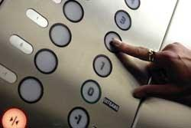
Looking Inside Lists
Just like strings, we can get at any single element in a list using an index specified in square brackets
>>> friends = [ 'Joseph', 'Glenn', 'Sally' ]
>>> print(friends[1])
Glenn
>>>
Joseph
Glenn
Sally
0
1
2

Slide 6
Lists are Mutable
>>> fruit = 'Banana'
>>> fruit[0] = 'b'
Traceback
TypeError: 'str' object does not
support item assignment
>>> x = fruit.lower()
>>> print(x)
banana
>>> lotto = [2, 14, 26, 41, 63]
>>> print(lotto)
[2, 14, 26, 41, 63]
>>> lotto[2] = 28
>>> print(lotto)
[2, 14, 28, 41, 63]
Strings are “immutable” - we cannot change the contents of a string - we must make a new string to make any change
Lists are “mutable” - we can change an element of a list using the index operator

Slide 7
List Methods
>>> x = list()
>>> type(x)
<type 'list'>
>>> dir(x)
['append', 'count', 'extend', 'index', 'insert', 'pop', 'remove', 'reverse', 'sort']
>>>

Slide 8
Tuples
Notes:
Note from Chuck. If you are using these materials, you can remove the UM logo and replace it with your own, but please retain the CC-BY logo on the first page as well as retain the acknowledgement page(s) at the end.

Slide 9
Tuples Are Like Lists
Tuples are another kind of sequence that functions much like a list - they have elements which are indexed starting at 0
>>> x = ('Glenn', 'Sally', 'Joseph')
>>> print(x[2])
Joseph
>>> y = ( 1, 9, 2 )
>>> print(y)
(1, 9, 2)
>>> print(max(y))
9
>>> for iter in y:
... print(iter)
...
1
9
2
>>>

Slide 10
but... Tuples are “immutable”
Unlike a list, once you create a tuple, you cannot alter its contents - similar to a string
>>> x = [9, 8, 7]
>>> x[2] = 6
>>> print(x)
>>>[9, 8, 6]
>>>
>>> y = 'ABC'
>>> y[2] = 'D'
Traceback:'str' object does
not support item
Assignment
>>>
>>> z = (5, 4, 3)
>>> z[2] = 0
Traceback:'tuple' object does
not support item
Assignment
>>>

Slide 11
Things not to do With Tuples
>>> x = (3, 2, 1)
>>> x.sort()
Traceback:
AttributeError: 'tuple' object has no attribute 'sort'
>>> x.append(5)
Traceback:
AttributeError: 'tuple' object has no attribute 'append'
>>> x.reverse()
Traceback:
AttributeError: 'tuple' object has no attribute 'reverse'
>>>

Slide 12
A Tale of Two Sequences
>>> l = list()
>>> dir(l)
['append', 'count', 'extend', 'index', 'insert', 'pop', 'remove', 'reverse', 'sort']
>>> t = tuple()
>>> dir(t)
['count', 'index']

Slide 13
Tuples are More Efficient
Since Python does not have to build tuple structures to be modifiable, they are simpler and more efficient in terms of memory use and performance than lists
So in our program when we are making “temporary variables” we prefer tuples over lists

Slide 14
Tuples and Assignment
We can also put a tuple on the left-hand side of an assignment statement
We can even omit the parentheses
>>> (x, y) = (4, 'fred')
>>> print(y)
fred
>>> (a, b) = (99, 98)
>>> print(a)
99

